Slide 1
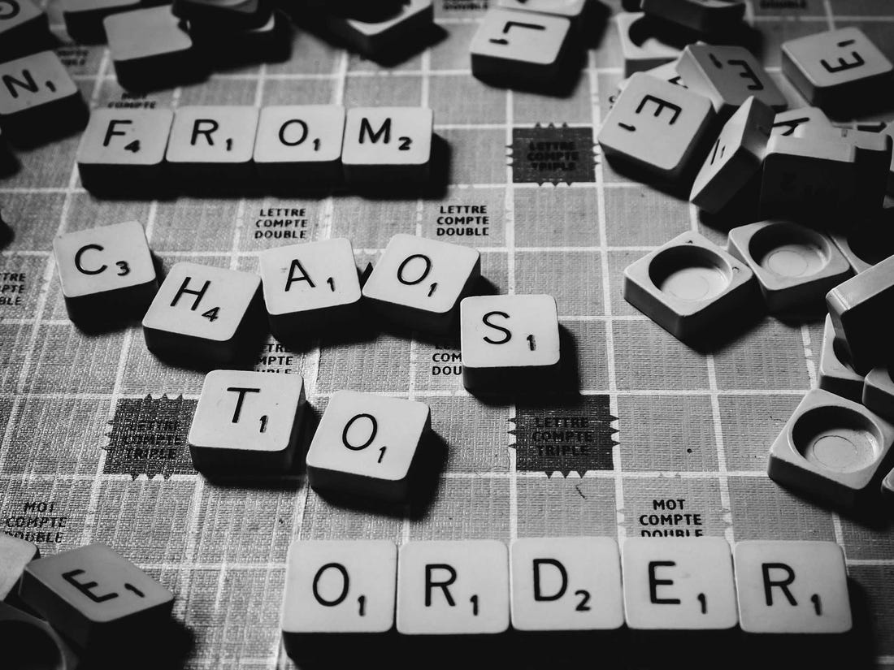
Mini Project by :
Shweta Kaware (A-05)
Karishma Bairi (Group Leader)
(A-14)
o
Aman Lakhotra (A-20)
Ketki Kulkarni (A-52)

Slide 2
Introduction
1) In learning English, vocabulary is one of some important elements for mastering.
2) Students can describe everything what they think without using grammar, but they cannot express anything without vocabulary .
3) In contradiction, many English teachers found students in schools have lack of vocabulary so it is difficult for them to study English.
4) So, most of students just gain a few vocabularies . Word scramble games are very old.
5) Word scramble games are fun, addictive, and a great way to keep your mind refreshed, cheerful and active .
6) So , here we are introducing our word game: CHAOS which is fun and vocabulary improving as well.

Slide 3
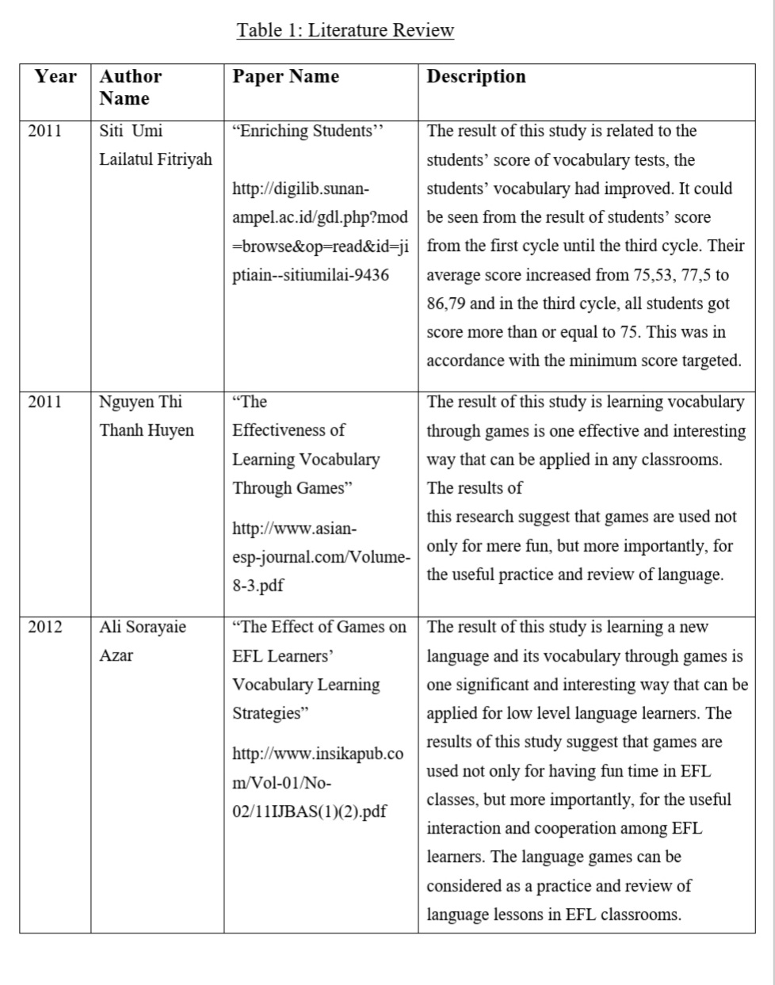
Litereture review

Slide 4
Problem statement
1) In the existing system of vocabulary learning, students don't get interest to learn it and this is very serious problem keeping in mind the future of students and their career. 2) To enhance their learning interest we came up with creation of a scramble game using Java language in which we written a code which gives a shuffled word to user and it asks user to guess the original word.
3) The user can guess the word until and unless it is guessed correct. When the user guesses the correct word, the game indicates that with a statement and the process ends.
4) By this way, the learning seems more interesting and students could also get familiar with technology.

Slide 5
Analysis
The data analysis was done by using statistical/analytical technique. The data analysis is used to describe the conclusion of the research data. Based on the data analysis of pre-test and post-test the researchers make tables as follows:
In this table, the researchers present the students’ pre-test to know the enhancement of students in vocabulary to see its frequency and percentage.
The frequency and percentage score of the students in pre-test can be seen in the table as follows:
Range of score | Classification | Frequency | Percent
90-100 | Excellent | 0 | 0 %
80-89 | Very Good | 0 | 0 %
70-79 | Good | 3 | 16.7 %
60-69 | Sufficient | 7 | 38.9 %
0-59 | Insufficient | 8 | 44.4 %
 | Total | 18 | 100 %
Table 1 Result of Pre-Test

Slide 6
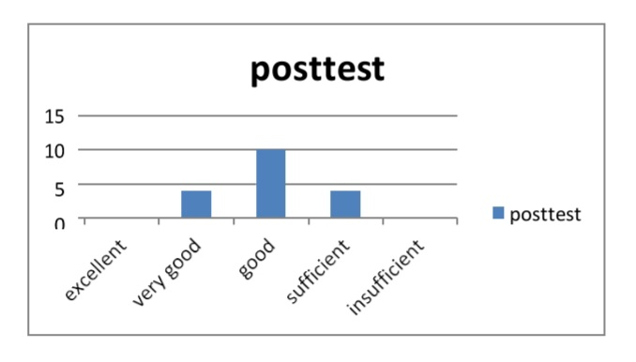
The data of the graphic above shows that there was category insufficient higher in pre-test before using scramble game.
In this table, the researchers present the students post-test to see its frequency and percentage.
The frequency and percentage score of the students in post-test can be seen in the table as follows:
Figure 2 The Result of Post-Test

Slide 7
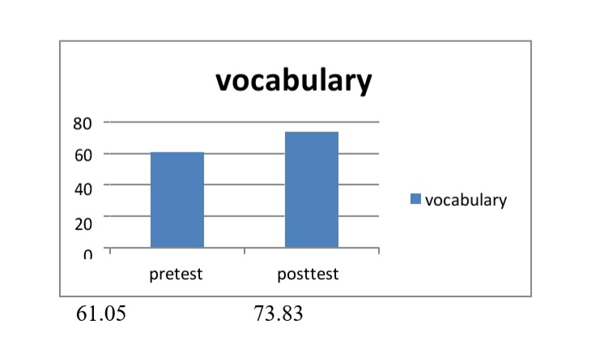
The data shows that there was higher mean score in post-test after teaching illustrative text through scramble game to improve students’ vocabulary.
It means that the difference between the pre-test and the post-test is 12.78%. That means the improvement in vocabulary of the students was consequent . This means that the data of the post-test which is the final result gave significant improvement.
It is concluded that the use scramble game in teaching and learning process especially in classroom activities can improve the students’ vocabulary.
Figure 3 Mean Score in Pre-Test and Post-Test

Slide 8
Scope of the project
Advantages of CHAOS GAME :
1
2
3
4.
5
6
7
8
9
This game assists with writing system.
It makes your kid work quicker.
It boosts memory.
It extends vocabulary.
It encourage problem-solving.
It is smart for competitive youngsters.
It is fun for the complete family.
It is an attractiveness to technician youngsters.
It assists with check preparation.

Slide 9
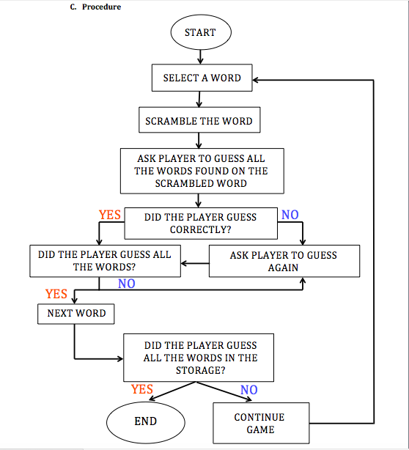
FLOWCHART

Slide 10
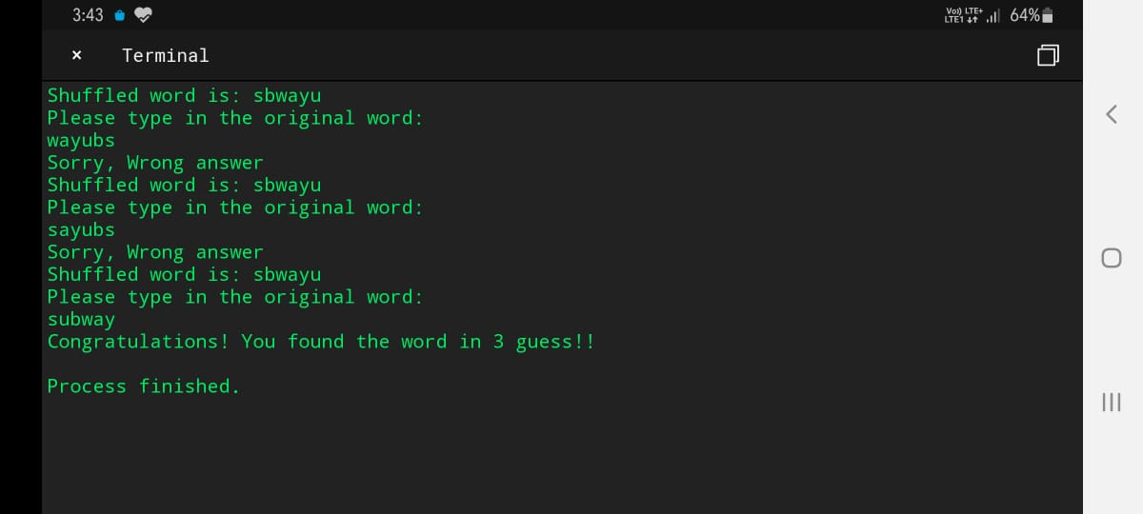
OUTPUT

Slide 11
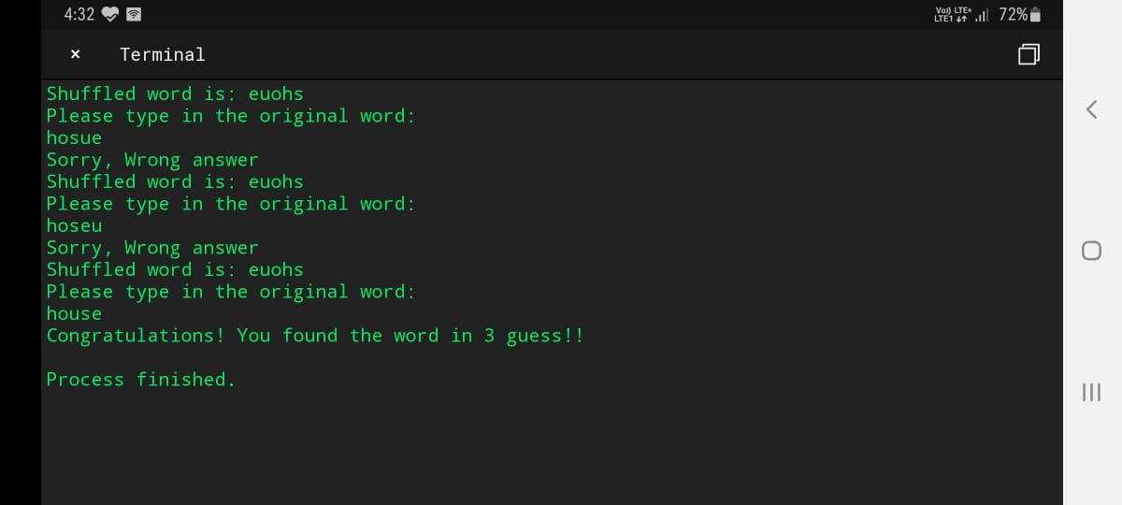

Slide 12
CONCLUSION
The use of scramble game can enhance the students’ vocabulary that is the mean score of the students’
The result of questionnaire is 71%. It means the students are interested to use scramble game to improve their vocabulary.
It is strongly suggested that the teaching of vocabulary through scramble game should be routinely implemented in teaching process.
It is firmly suggested for the teachers to use this medium in teaching English in different skills such as listening, reading and speaking that can increase the students’ interest in joining the class because students can learn English enjoying and fun through new media that motivates them to study.
Scramble game is the interesting way to enhance students’ skill in English. Henceforth, we have come up with our version of the game called CHAOS. Using this game, we hope students would find it interesting to develop their vocabulary by their own.

Slide 13
REFERENCES
https://www.britannica.com/sports/Scrabble
https://www.aldictionary.com/scrabble-dictionary/definition/objectives.html
https://www.ukessays.com/essays/computer-science/literature-review-on-the-research-on-games-computer-science-essay.php
https://www.theschoolrun.com/10-ways-word-puzzles-can-help-your-child
https://www.researchgate.net/publication/324942343_THE_SCRAMBLE_GAME_IN_IMPROVING_STUDENTS'_VOCABULARY_AT_THE_SEVENTH_GRADE_OF_MTS_LKMD_SAWA
https://images.app.goo.gl/oVeCDXGPeHyLzhx87
https://www.academia.edu/35186999/TEACHING_ENGLISH_THROUGH_SCRABBLE_GAMES_FOR_ELEMENTARY_SCHOOL
https://www.ukessays.com/essays/english-language/analysis-of-the-board-game-scrabble-english-language-essay.php
https://www.slideshare.net/mobile/NadiaIIT/final-project-report-of-a-game

Slide 14
MINI PROJECT GUIDE : DR SIDDHARTH HARIHARAN
THANK YOU !!!

